Slide 1




PEMBUATAN MINI SCADA HMI DENGAN BAHASA PEMROGRAMAN PYTHON DAN QML UNTUK PLC OUTSEAL Practical Training Handout
Written by :
Muhammad Husni Muttaqin, S. Pd
Lab. Mekatronika Politeknik Elektronika Negeri Surabaya dan Komunitas Belajar Arduino dan Mekatronika
2023

Slide 2
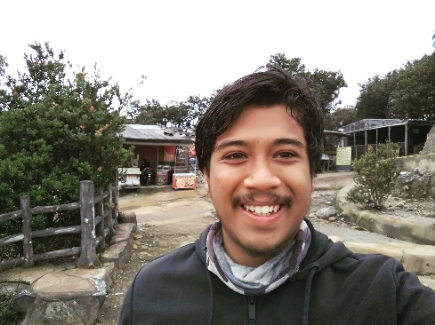
About me
Name : Muhammad Husni Muttaqin, S. Pd.
Birth date : 5 June 1998
Hometown : Bandung
Current Job : python programmer at PT Syergie Indoprima and Founder of Ardumeka Community
Experiences :
- 2019 - 2020 : Dynamics Positioning System engineer on cable ship (PT Syergie Indoprima)
- 2021 - 2022 : RnD engineer for Vent-I (PT Syergie Automa Teknologi)
- 2022 – now : Python Programmer PT Syergie Indoprima

Slide 3
REVIEW HMI SCADA

Slide 4
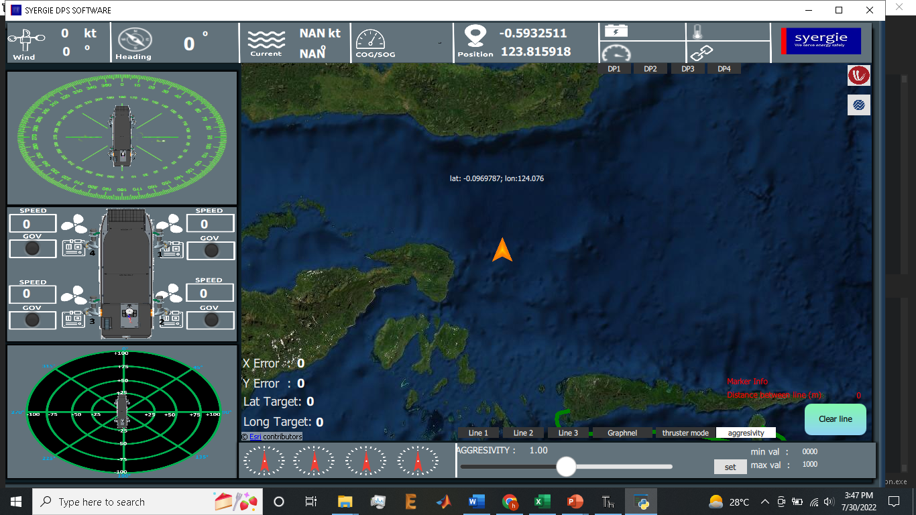
Apa saja yang saya sudah buat dengan python QML
1. Software Dynamic Positioning System

Slide 5
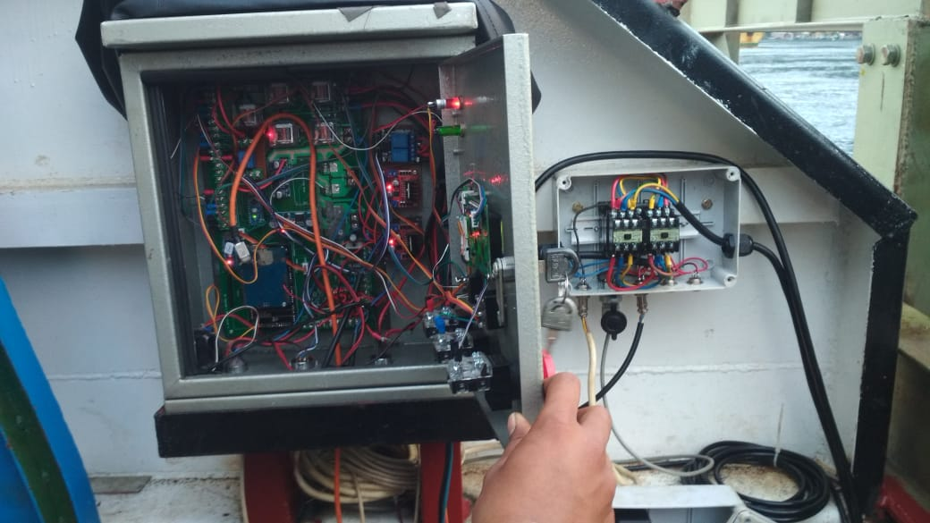
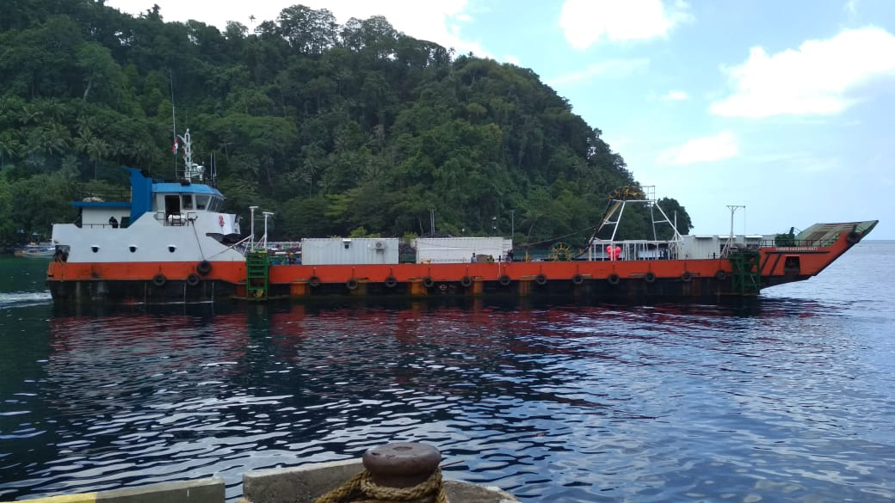
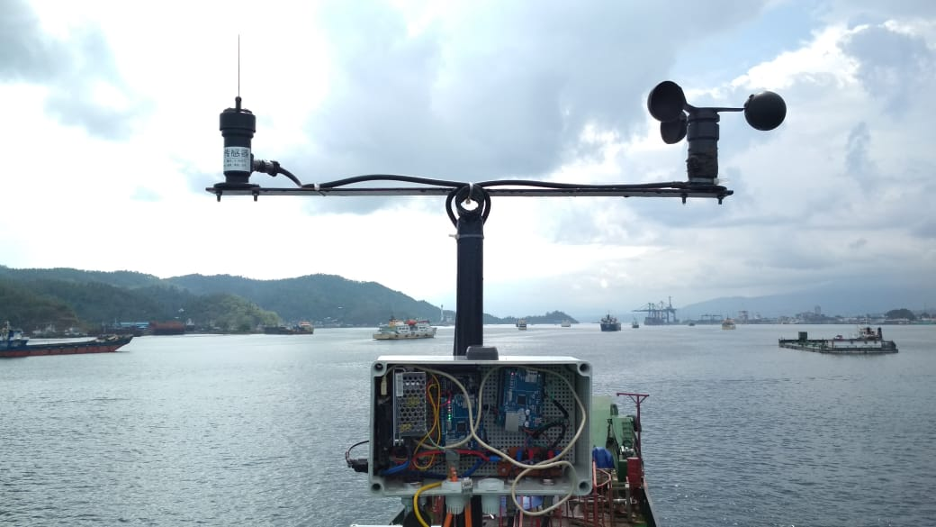
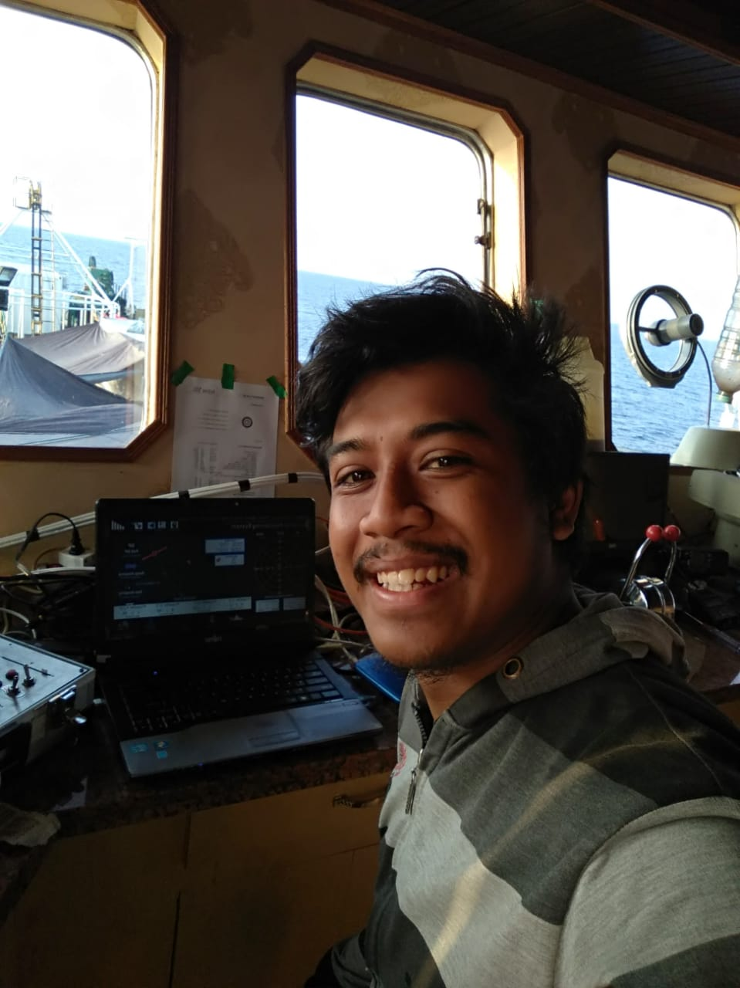
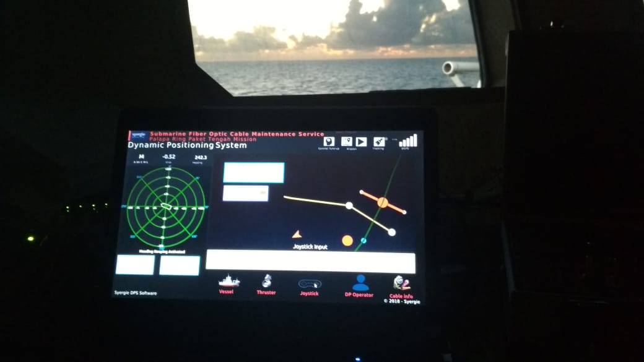

Slide 6
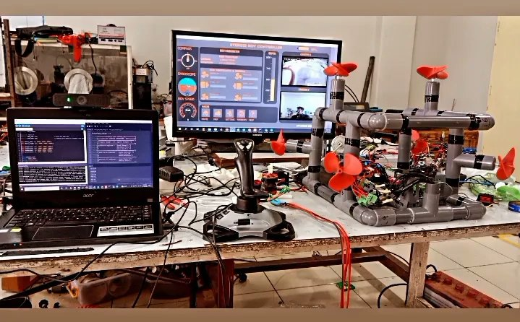
Apa saja yang saya sudah buat dengan python QML
4. Software kendali Underwater ROV

Slide 7
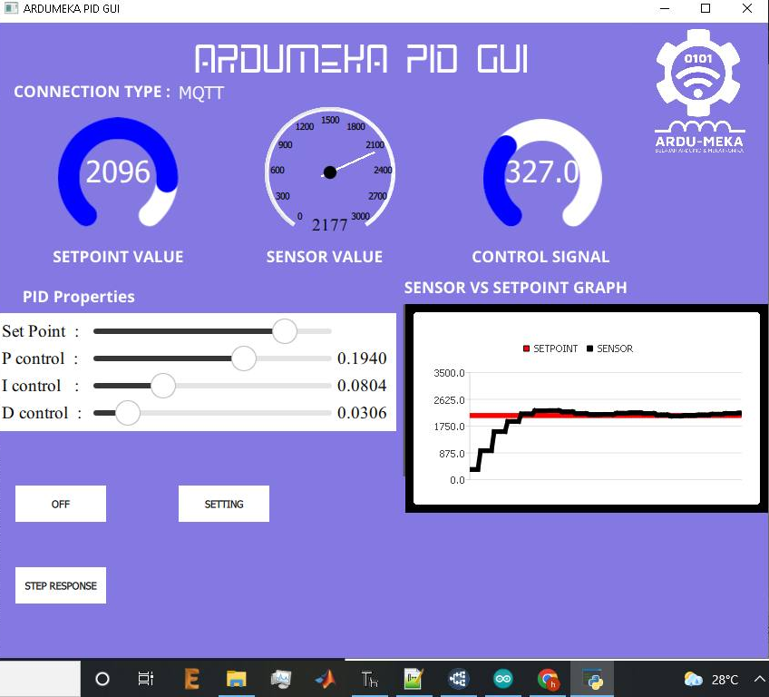
Apa saja yang saya sudah buat dengan python QML
6. Ardumeka PID GUI

Slide 8
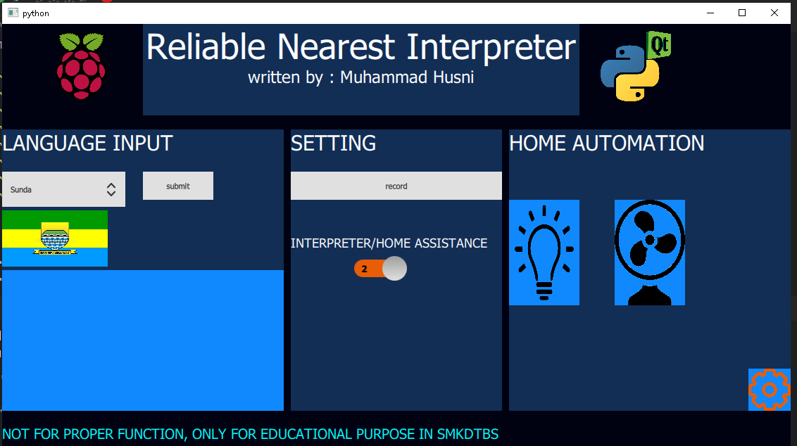
Apa saja yang saya sudah buat dengan python QML
7. On progress : ReNI (Reliable Nearest Interpreter)

Slide 9
timeline
??? minutes practice
30 Closing Ceremony
30 minutes preparation
Total : 6 Hours

Slide 10
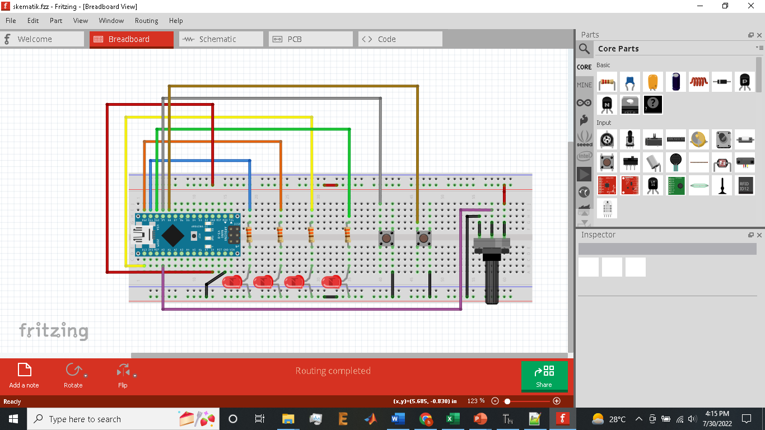
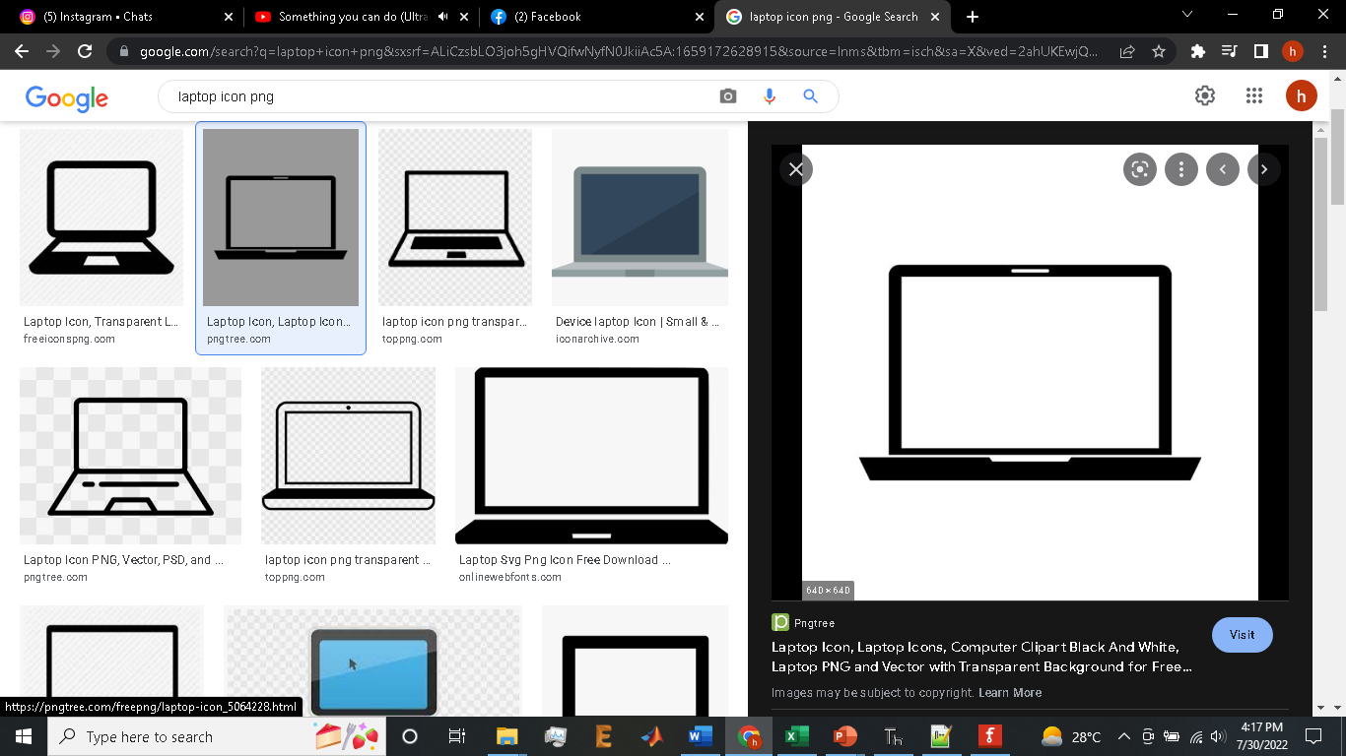
Yang biasa saya lakukan

Slide 11
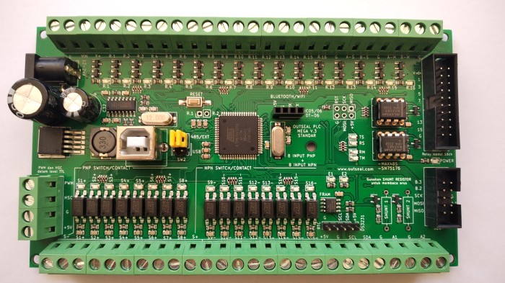
Yang hari ini kita lakukan

Slide 12
Today Workshop Project

Slide 13
Preparation
Software Installation
Notepad++
Thonny IDE
- PyQt5 Library ver 5.15.7
- PyModbus Library ver 2.3.0
Outseal Studio
CH340 Driver

Slide 14
Preparation
Software testing
Upload example outseal code
Testing example python code

Slide 15
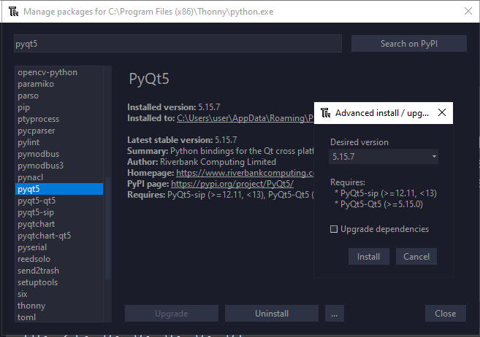

Slide 16
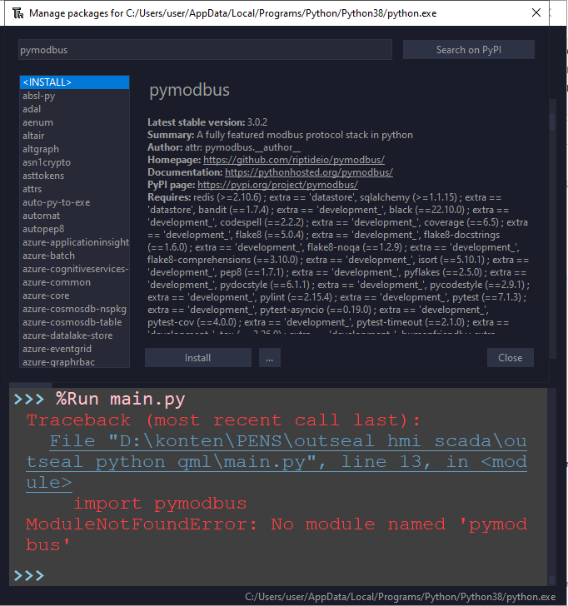
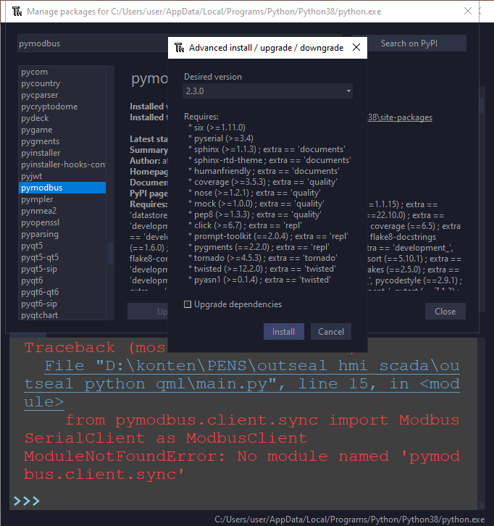

Slide 17
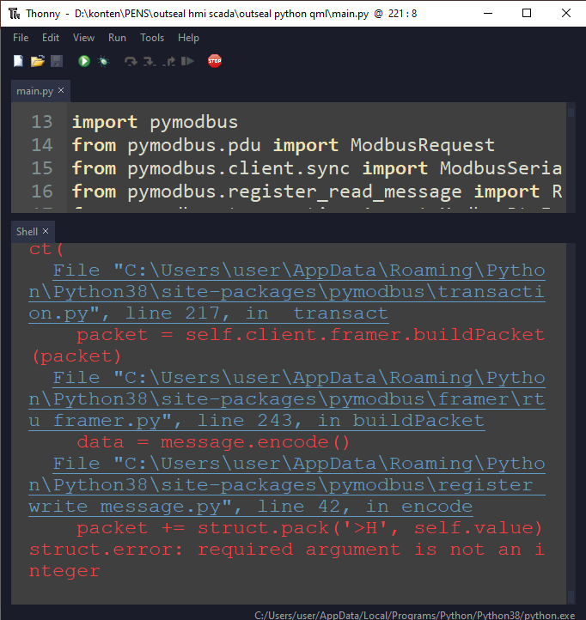
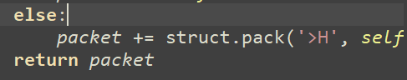
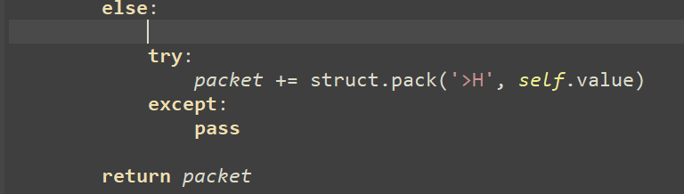

Slide 18
Hardware Wiring

Slide 19
RUN EXAMPLE CODE FIRST TO MAKE SURE PREPARATION DONE PERFECTLY ☺

Slide 20
TODAY JOBSHEET
1. Digital Output
2. Digital Input
3. Analog Input
4. Analog Output
5. Membuat grafik dengan PyQt Chart
6. Membuat Tampilan Halaman

Slide 21
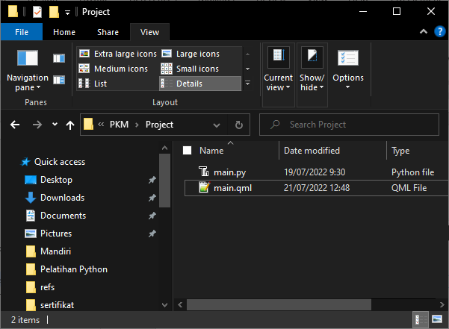
Create new folder
.py
.qml

Slide 22
Python base code
from PyQt5.QtCore import *
from PyQt5.QtGui import *
from PyQt5.QtQml import *
from PyQt5.QtWidgets import *
from PyQt5.QtQuick import *
import sys
class table(QObject):
def __init__(self, parent = None):
super().__init__(parent)
self.app = QApplication(sys.argv)
self.engine = QQmlApplicationEngine(self)
self.engine.rootContext().setContextProperty("backend", self)
self.engine.load(QUrl("main.qml"))
sys.exit(self.app.exec_())
if __name__ == "__main__":
main = table()

Slide 23
Qml base code
import QtQuick 2.12
import QtQuick.Window 2.13
import QtQuick.Controls 2.0
import QtQuick.Controls.Styles 1.4
import QtQuick.Extras 1.4
import QtQuick.Extras.Private 1.0
Window {
id : root
width: 400
height: 400
title:"membuat windows"
color : "pink"
visible: true
//flags: Qt.WindowMaximized //Qt.Dialog
}

Slide 24
Experiment
Make your windows with your favorite color ☺

Slide 25
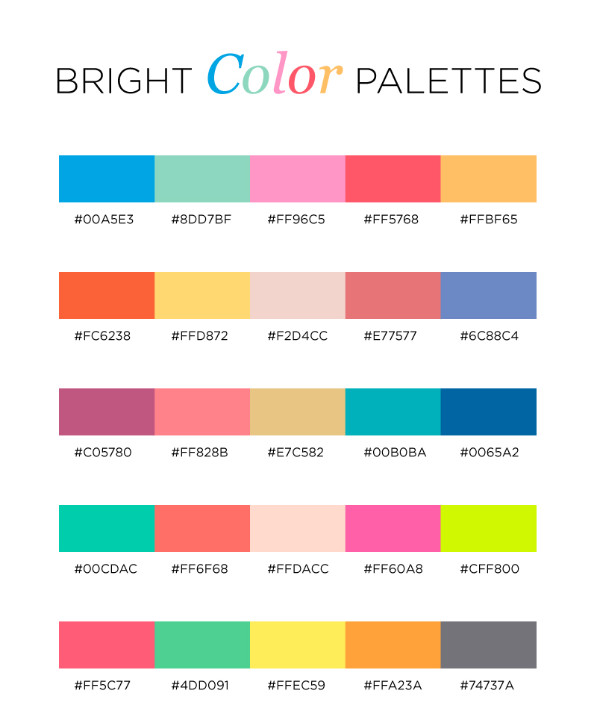
Little tricks => color pallete
color : “#FF96C5"

Slide 26
Add some text on your window
Text{
id : text1
x:100
y:200
text:"Hello World"
color: "#00FF00"
font.family : "Comic Sans MS"
font.pixelSize: 35
font.bold : true
}
WRITE YOUR NAME ON YOUR WINDOW

Slide 27
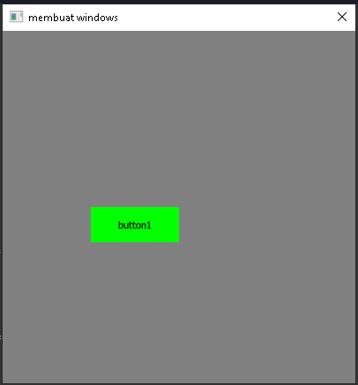
Add some buttons on your window
Button {
id: button1
x :100
y :200
text: "button1"
palette {
button: "#00FF00"
buttonText: "black"
}
onClicked:{
}
}
MAKE THREE BUTTONS

Slide 28
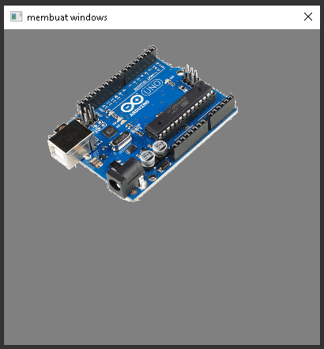
Add some picture on your window
Image{
x:50
y:0
width : 250
height : 250
source: "arduino.png"
}

Slide 29
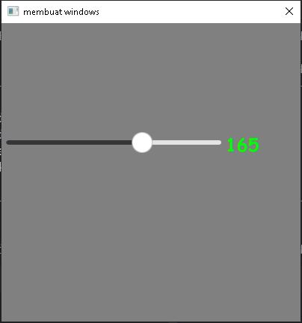
Add slider on your window
Slider {
id: slider1
x:0
y:150
height: 20
width: 300
value: 0
from:10
to: 255
stepSize: 5
orientation: Qt.Horizontal
onValueChanged: {
}
}

Slide 30
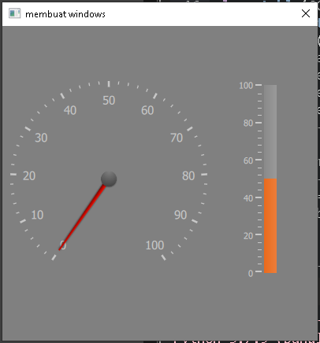
Add gauge on your window
Gauge {
id : gauge2
x: 300
y: 70
height : 250
width : 250
minimumValue: 0
value: 50
maximumValue: 100
tickmarkStepSize: 20
style: GaugeStyle {
valueBar: Rectangle {
color: "#e85d08"
implicitWidth: 16
}
}
}

Slide 31
Add circular gauge on your window
CircularGauge {
id : gauge1
x: 10
y: 70
height : 250
width : 250
value: 0
minimumValue: 0
maximumValue: 100
style: CircularGaugeStyle {
labelStepSize: 10
}
}

Slide 32
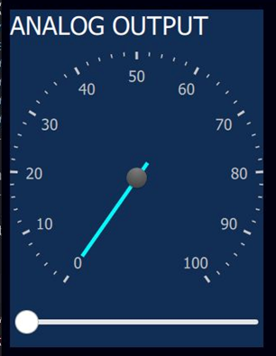
Little tricks => grouping using Rectangle
Rectangle{
x: 200
y:0
width : 600
height : 130
color : "#122e55"
//insert your QML Component inside here ☺
}

Slide 33
Integrate python with qml
Python <= QML
class table(QObject):
def __init__(self, parent = None):
super().__init__(parent)
self.app = QApplication(sys.argv)
self.engine = QQmlApplicationEngine(self)
self.engine.rootContext().setContextProperty("backend", self)
self.engine.load(QUrl("main.qml"))
##############TOMBOL QML KE PYTHON ##########
@pyqtSlot(str)
def button1(self, message):
print(message)
##########SLIDER QML KE PYTHON###################
@pyqtSlot(str)
def analog_output(self, message):
print(message)
Button {
…….
onClicked:{
backend.button1("clicked")
}
}
Slider {
…….
onValueChanged:{
backend.button1("clicked")
}
}

Slide 34
Integrate python with qml
Python => QML
Timer{
id:transferdata
interval: 50
repeat: true
running: true
onTriggered: {
pot_val.text = backend.get_analog()
}
}
##########KIRIM DATA ANALOG KE GAUGE##############
@pyqtSlot(result=float)
def get_analog(self): return analog

Slide 35
Python to Arduino Data Parsing
Preparations :
Make sure the wiring was correct
Make sure the COM was detected, if not you must install CH340 driver
- Upload “FIRMWARE.INO” to your Arduino
- Test by using the my example code

Slide 36
Port scan python
print ("select your arduino port:")
def serial_ports():
if sys.platform.startswith('win'):
ports = ['COM%s' % (i + 1) for i in range(256)]
elif sys.platform.startswith('linux') or sys.platform.startswith('cygwin'):
# this excludes your current terminal "/dev/tty"
ports = glob.glob('/dev/tty[A-Za-z]*')
elif sys.platform.startswith('darwin'):
ports = glob.glob('/dev/tty.*')
else:
raise EnvironmentError('Unsupported platform')
result = []
for port in ports:
try:
s = serial.Serial(port)
s.close()
result.append(port)
except (OSError, serial.SerialException):
pass
return result
print(str(serial_ports()))
port = input("write port : ")
ser = serial.Serial(port, 9600, timeout=3)

Slide 37
Basic serial communication

Slide 38
Let’s see the result ☺

Slide 39
Thanks for your participation, I hope this means more for all of you ☺

Slide 40
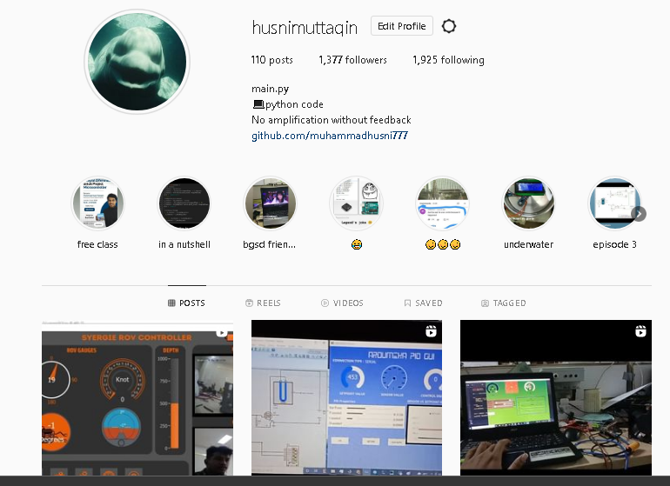
My Instagram

Slide 41
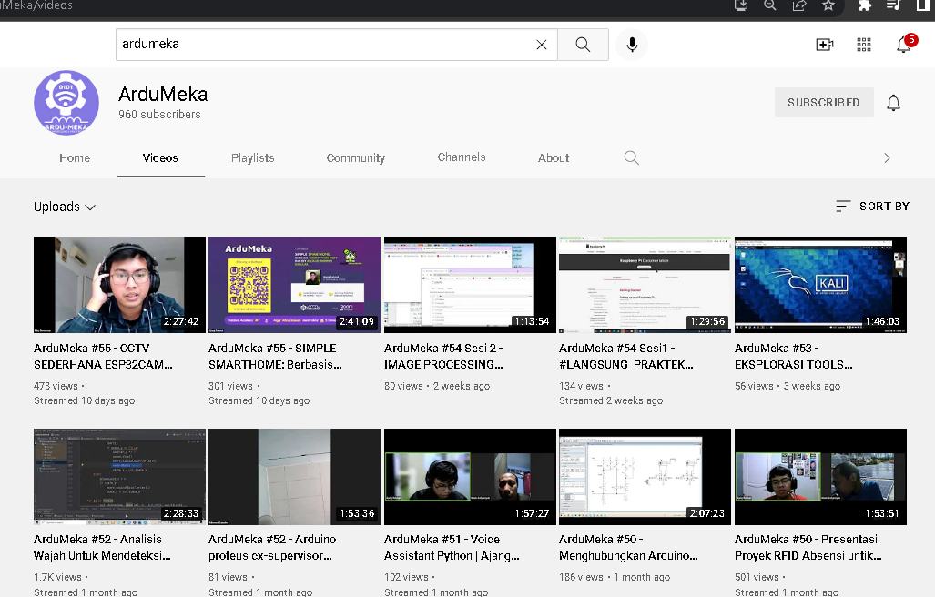
SUPPORT US

